Slide 1
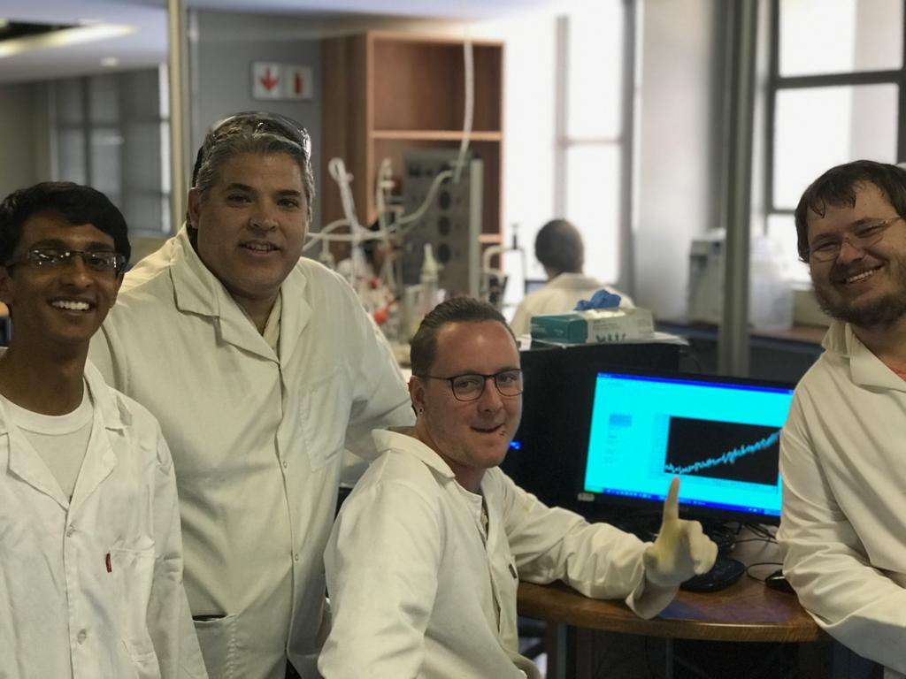
CLB 321: Chemical Kinetics 2019 - Group 19
A.M Barrios
B Bhaga
J Clasen
J.M Webber
96011930
17094128
15189385
12100952

Slide 2




Background
Reaction:
CH3COOCH2CH3+NaOH→CH3COONa+CH3CH2OH (A+B→C+D)
Reaction rate:
$$r_{A} = − k∙C_{A}^{m}∙C_{B}^{n}$$
Batch mole balance:
$${{dF}_{A}}/{dt}= r_{A}∙V$$
PFR mole balance:
$${{dF}_{A}}/{dV}= r_{A}$$
CSTR mole balance:
$$F_{AO} − F_{A}=− r_{A}∙V$$

Slide 3
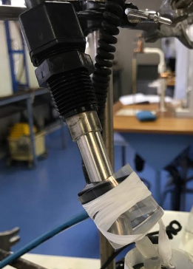
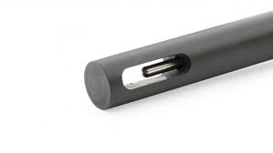


Experimental procedure
Conductivity Probe:
Insertion
No bubbles
Angled
Re-insert
Twist
Data reading
BEFORE reaction
Measures K
$$x= \frac{K_{Start} −K}{K_{Start} − K_{End}}$$
$$C_{NaOH}=0.02∙(1 −x)$$

Slide 4
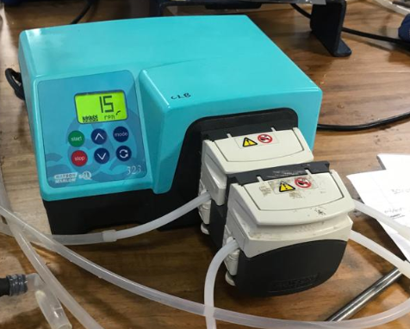
Pump:
Rpm conversion:
Set rpm
Select volume (in mL)
Time
Compensating for added head:
Rpm conversion
Add pipes to reactor
Measure flow rate at reactor outlet
Adjust rpm

Slide 5
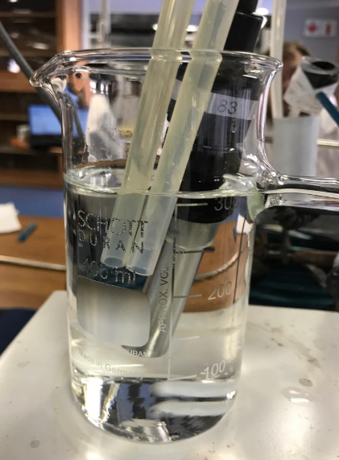
CSTR

Slide 6
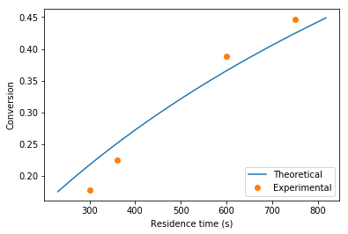
Conversion vs time for single CSTR

Slide 7
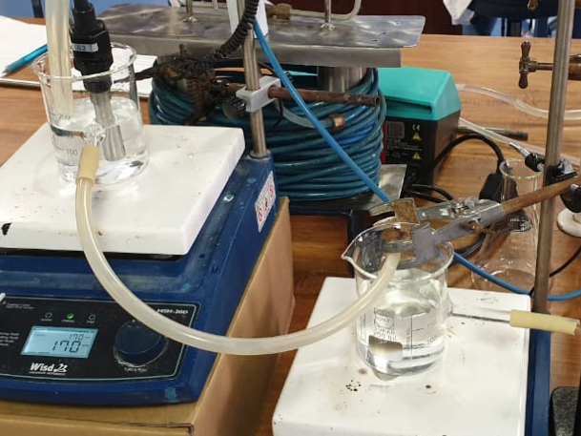
Two CSTR’s in Series

Slide 8
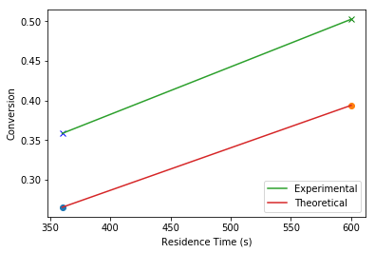
Conversion vs time for 2 CSTR’s in series

Slide 9
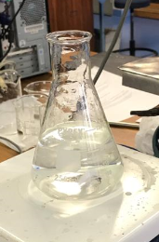
Batch
K_{start}
Measure 0.02 mol/L NaOH
Insert conductivity probe
Reaction
Add 100 mL each of
0.04 mol/L NaOH
0.08 mol/L Ethyl Acetate
Estimated run time:
25 minutes with conductivity probe
K_{finish}
1 hour after other experiments
Insert conductivity probe
Conversion
Experimental: 93%
Theoretical: 79%

Slide 10
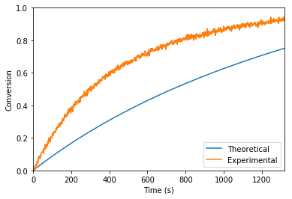
Conversion vs time for batch reactor

Slide 11
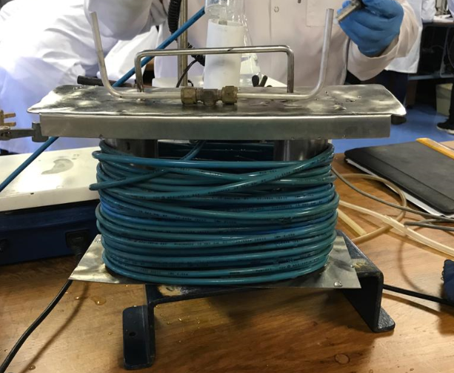
PFR

Slide 12
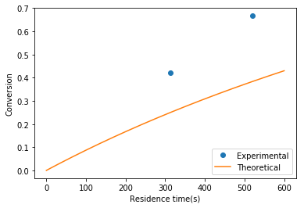

Slide 13
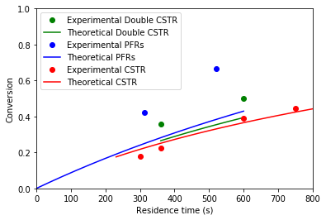
Results
Conversion vs residence time (calculated from the Batch run):

Slide 14

Rate constant (k) at ambient temperature
k = , m = , n =
Units:
$r_{A} = − k∙C_{A}^{m}∙C_{B}^{n}$
$\left[\frac{mol}{L∙s}\right]=\left[\frac{L^{(m+n−1)}}{{mol}^{(m+n−1)}∙s}\right]∙{\left[\frac{mol}{L}\right]}^{m}∙{\left[\frac{mol}{L}\right]}^{n}$
$$∴k= [\frac{L^{}}{{mol}^{}∙s}]$$

